Slide 1
Violence Alert Chatbot
Team 59 (ctrl+alt+hackHERS)

Slide 2

TEAM MEMBERS
&
ROLES
1 | Vibha Rao (Code)
2 | Manvi Gawande (Code)
3 | Srushti Satalkar (Code)
4 | Vaidehi Pawar (Code)
5 | Jeevika Sirwani (Integration)
6 | Rakshita Khidbide (Integration)

Slide 3

Guardian

Slide 4

Problem Statement
The use of CCTV surveillance is utilised more frequently, however it continues to lack an automated identification of violence functionality. Manual surveillance isn't practical, and the amount of time needed to react to an emergency is critical. The concept of a real-time violence notification

Slide 5
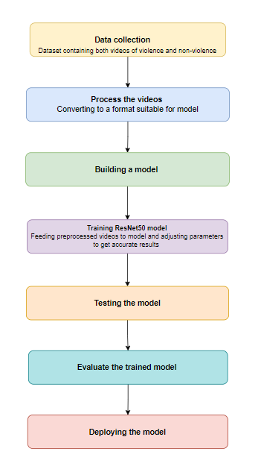
Flow of the
Project

Slide 6
Solution (Cont’d)
For violence detection, ResNet50 can be used to extract features from CCTV videos. These features can then be used to train a classifier to distinguish between violent and non-violent videos.
The steps involved in using ResNet50 for violence detection are as follows:
Collect a dataset of CCTV videos, including both violent and non-violent videos.
Preprocess the videos, such as by resizing them and converting them to grayscale.

Slide 7
Solution (Cont’d)
Train a classifier on the extracted features.
Use the classifier to detect violence in new videos.
ResNet50 is a powerful tool that can be used for violence detection.

Slide 8
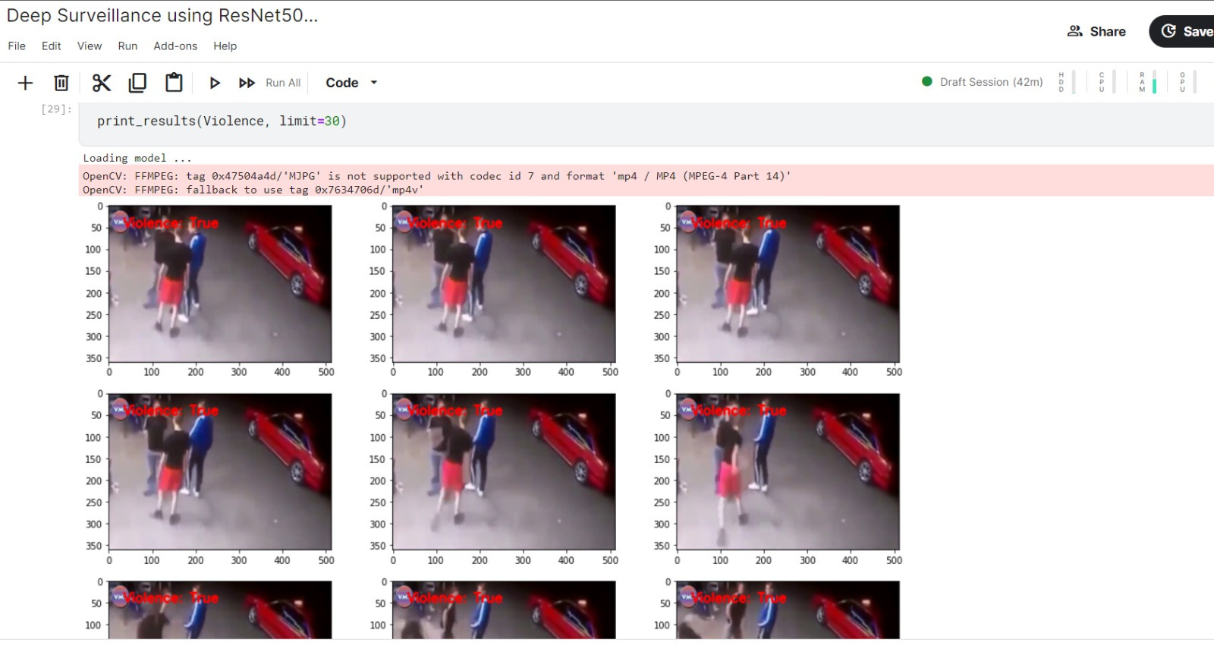
Solution Images

Slide 9
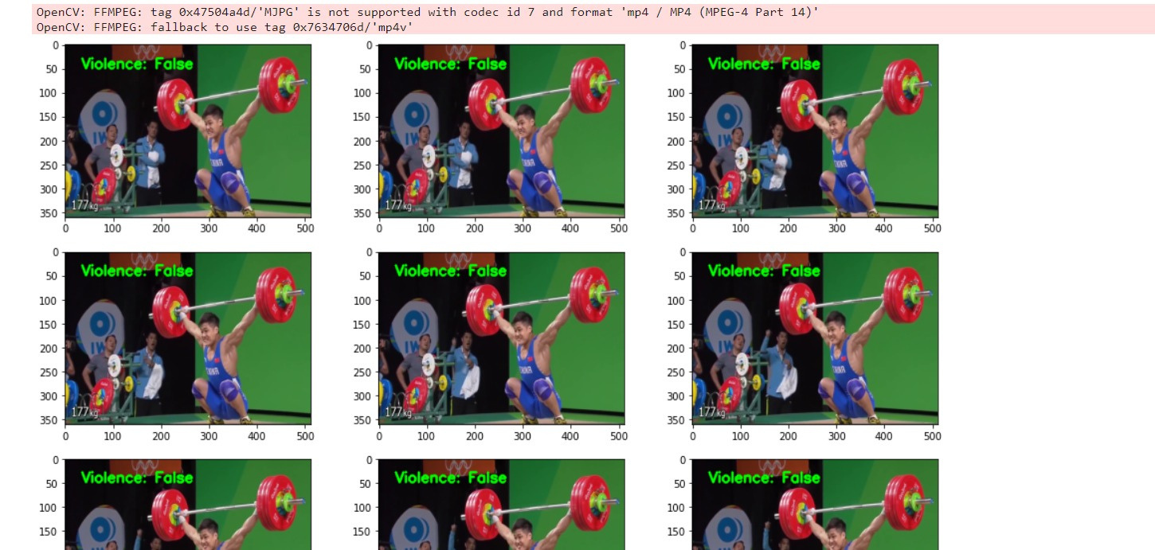
Solution Images

Slide 10
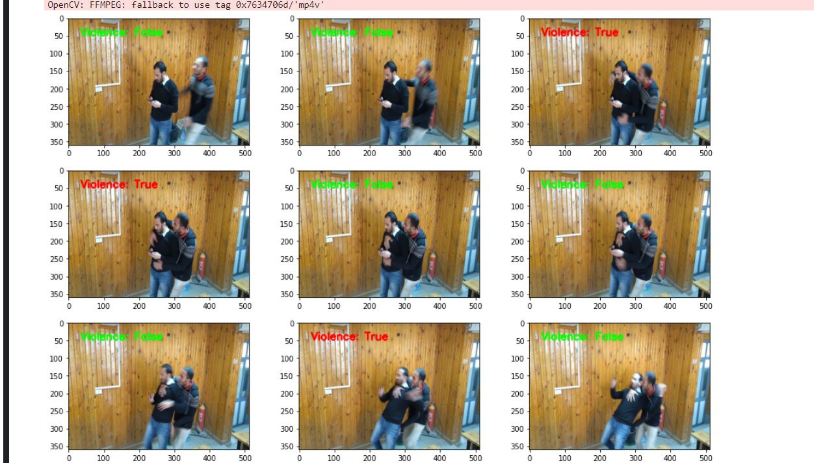
Solution Images

Slide 11
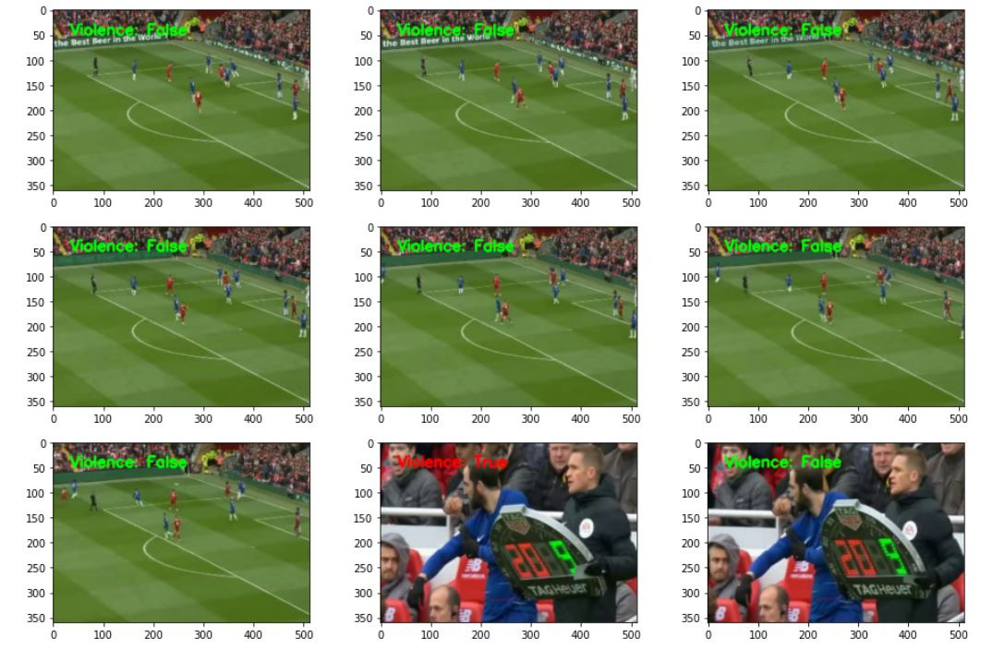
Solution Images

Slide 12
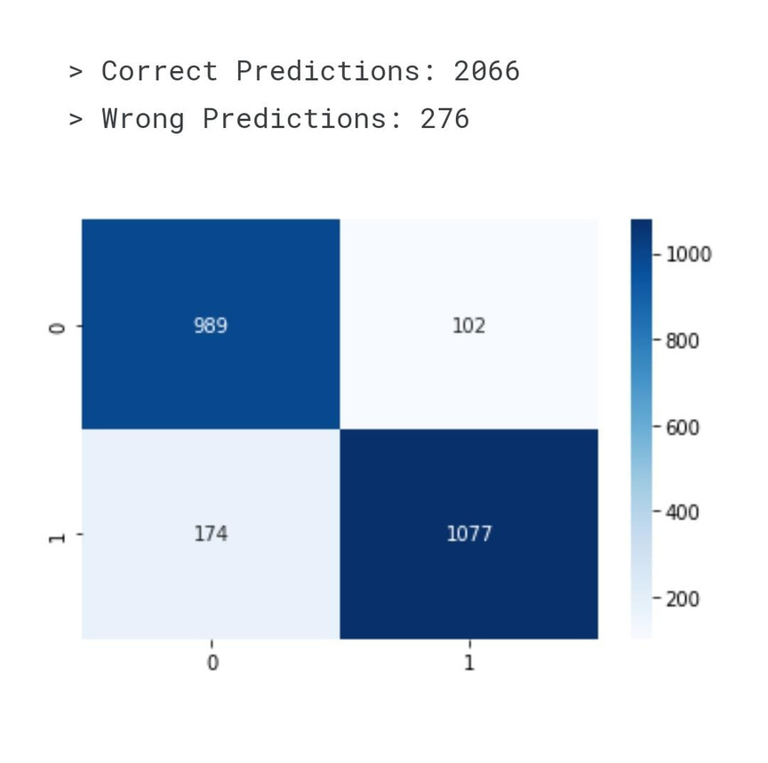
Confusion Matrix

Slide 13
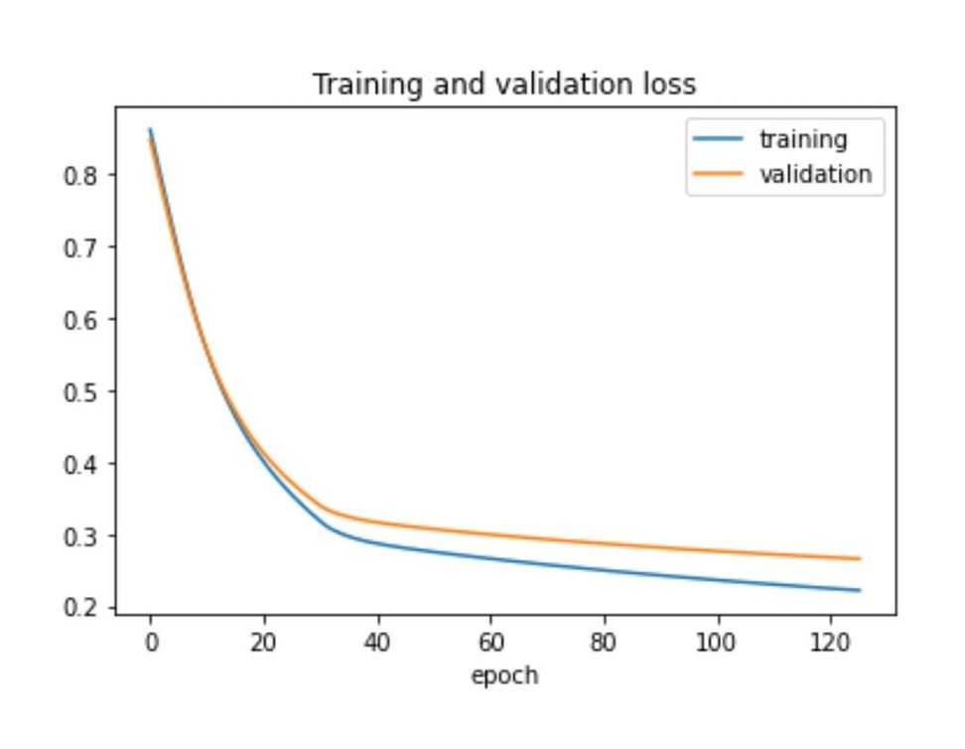
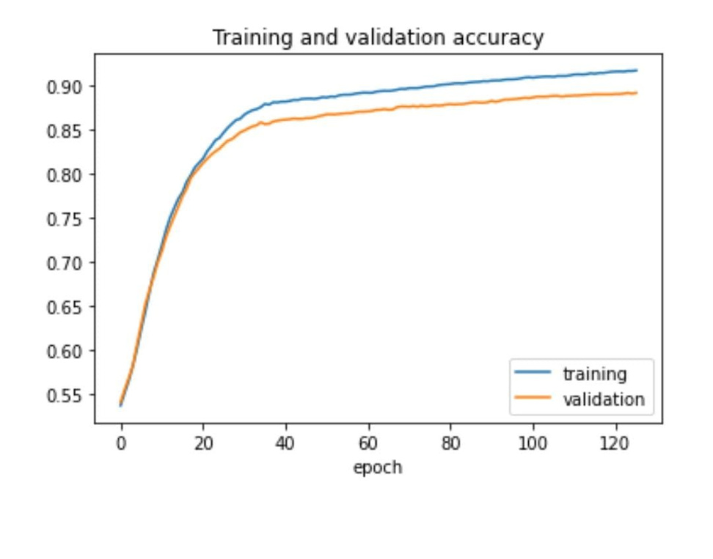
Training and Validation
Training and validation accuracy is increasing and loss is decreasing

Slide 14
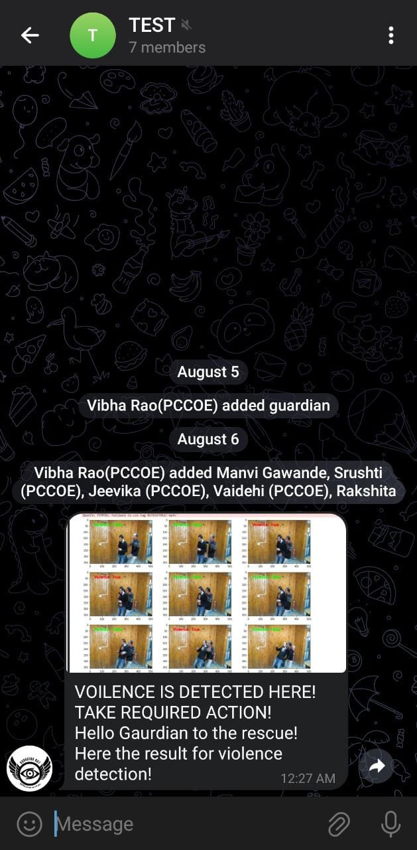
ChatBot
output
on
telegram

Slide 15
Wow Factor
A real-time violence alarm system is impressive because it may be able to save lives. The device can give people enough time to take protective measures by alerting them instantly when violence is detected. This can entail running away, phoning the police, or hiding.
A real-time violence alarm system can help prevent violence while also saving lives. People may not be as likely to engage in violent behaviour in the first place if they are aware that they are under scrutiny and that their conduct will be recorded.

Slide 16
Wow Factor (cont'd.)
A real-time violence alarm system has the following further advantages:
Reduced risk of violence occurring; an increased sense of security for both individuals and communities; and a greater understanding of potential violence.
A real-time violence alarm system's ability to actually change the world is what makes it so amazing. It might contribute to lifesaving, violence prevention, and community safety.
Greater accountability for violent offenders
A quicker reaction to violent occurrences

Slide 17
Future Scope
Multimodal Sensing: Integrating multiple sensing modalities, such as audio analysis and body language recognition, can provide a more comprehensive understanding of potentially violent situations, leading to more accurate and timely alerts.
Scalability and Integration: Designing the system to be easily scalable and adaptable to different environments, such as schools, workplaces, public places, etc., will be essential for broader adoption.

Slide 18
Future Scope
Geolocation and Mapping: Integrating geolocation data with the system can help track patterns of violence and identify high-risk areas, allowing for targeted preventive measures.
Emergency Response Integration: Collaborating with law enforcement and emergency response services to integrate the violence alarm system into their operations can facilitate a quicker and more effective response to incidents.

Slide 19
Let’s Jump into the Demo!

Slide 20
THANK YOU

